Slide 1
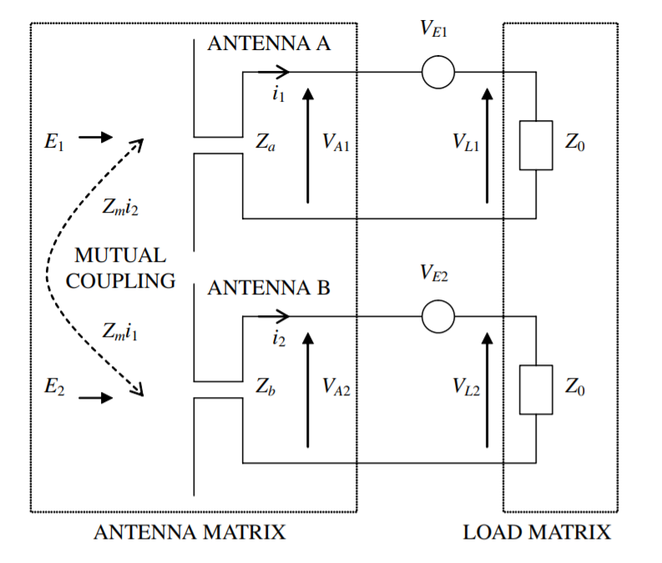
Mutual Coupling in MIMO systems

Slide 2
Prerequisites for Simulation
Need to generate coupling matrix for MIMO Systems
Most cited paper used for modelling mutual coupling is the following
Wu, Y., Linnartz, J. P., Bergmans, J. W. M., & Attallah, S. (2008, May). Effects of antenna mutual coupling on the performance of MIMO systems. In 29th Symposium on Information Theory in the Benelux (pp. 1-8).

Slide 3
Mutual Coupling Matrix
Frequency
Antenna Type
Antenna Dimension
Antenna Spacing
No. Of Antenna Elements
MIMO
Mutual Coupling Matrix Generator
Coupling Matrix
Z parameters depends on S parameters
S parameters depends on
Antenna Array
Frequency
Antenna Array depends on
Antenna Type
Antenna Dimension (Length / Width)
Antenna Spacing
Number Of Antenna Elements

Slide 4
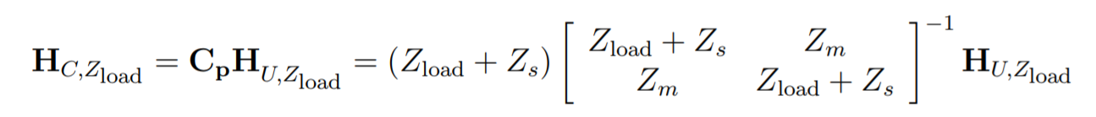
Generating Mutual Coupling Matrix
Uncoupled Channel Matrix
Coupled Channel Matrix
Zs = Rs + jXs : self impedance of the antenna
Zm = Rm + jXm : mutual impedance between the antennas
Zload = Rload + jXload : loading impedance of the antennas
Wu, Yan, et al. "Effects of antenna mutual coupling on the performance of MIMO systems." 29th Symposium on Information Theory in the Benelux. 2008.

Slide 5
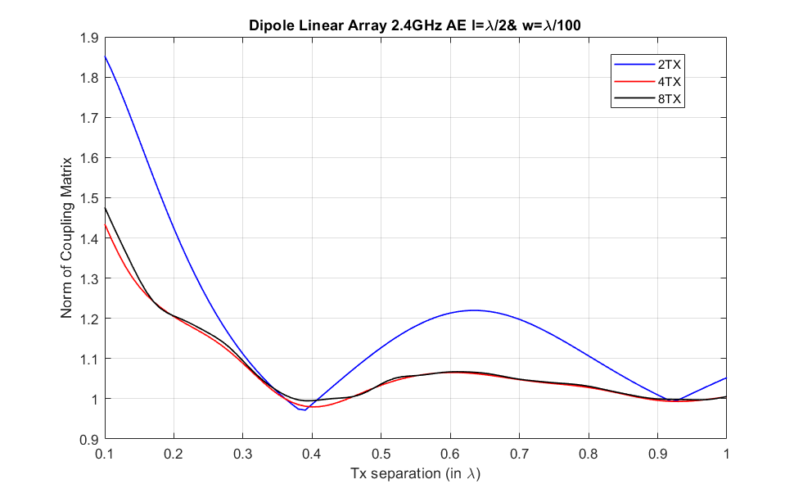
Coupling Matrix Norm vs Tx Separation

Slide 6
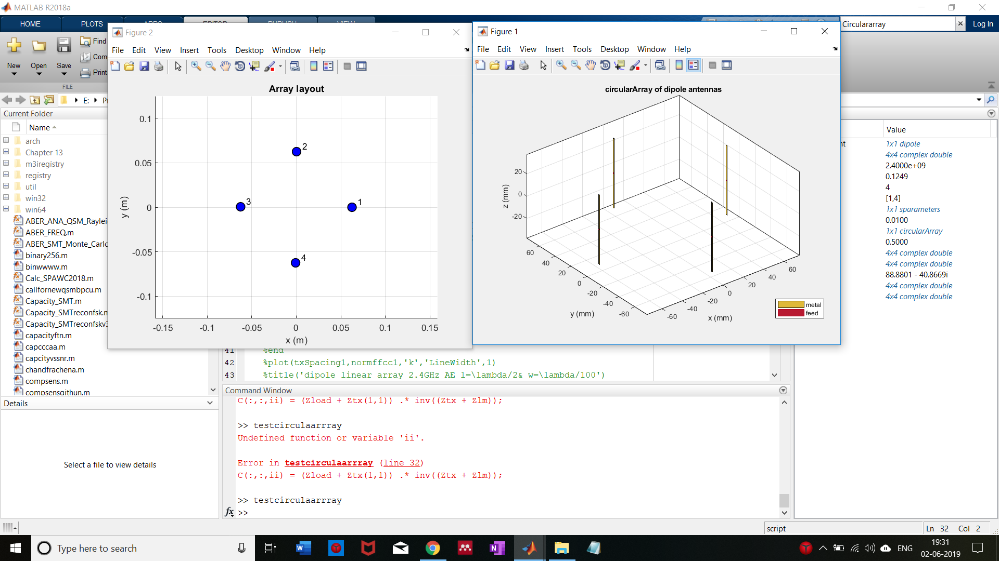
4 Element Dipole Circular Array
SQRT(2r^2)
r
r

Slide 7
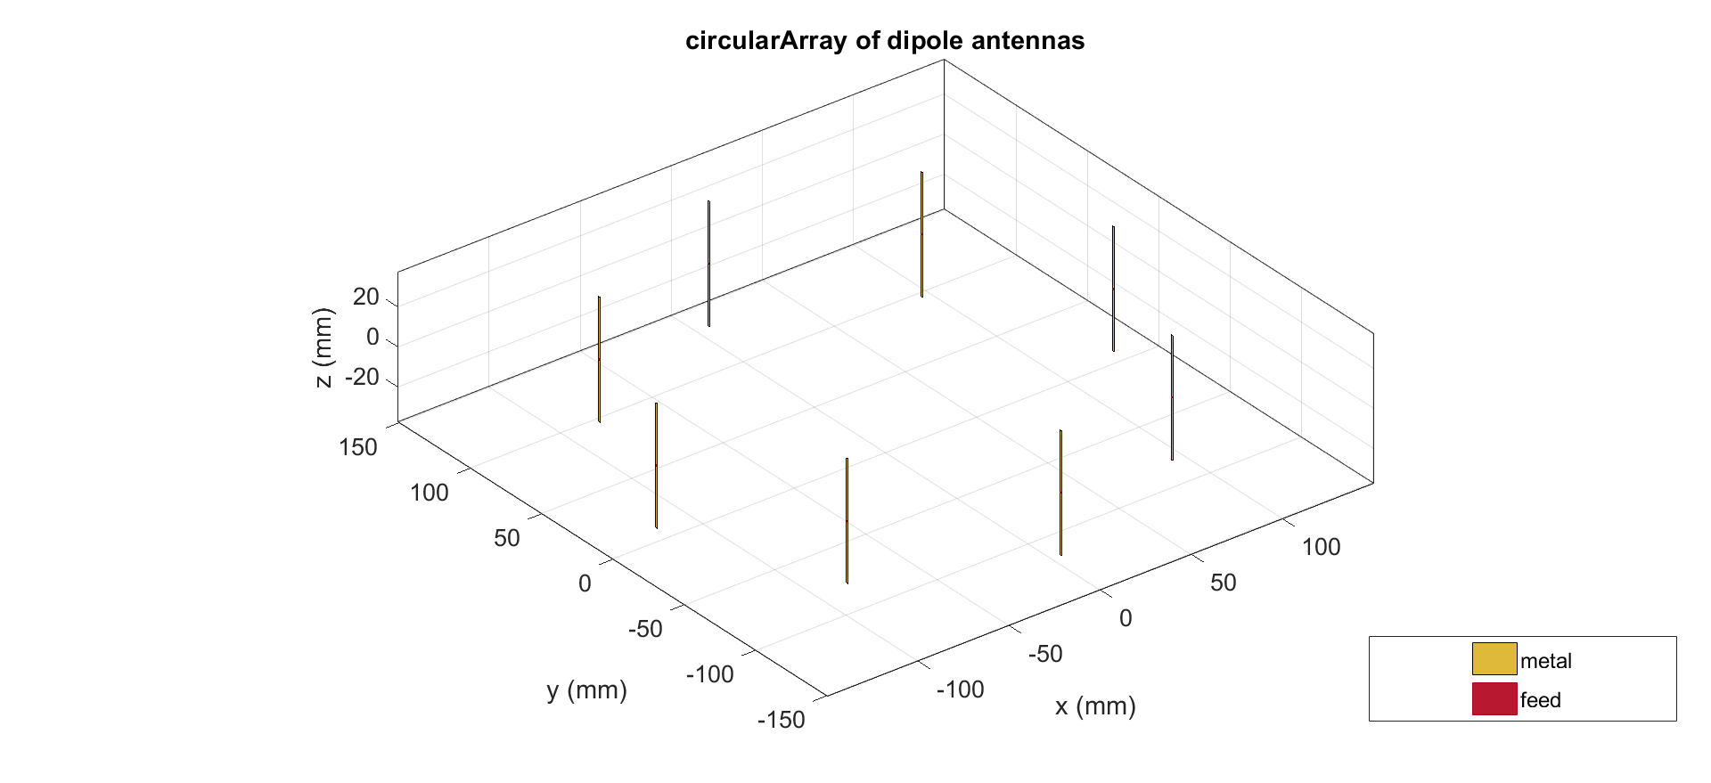
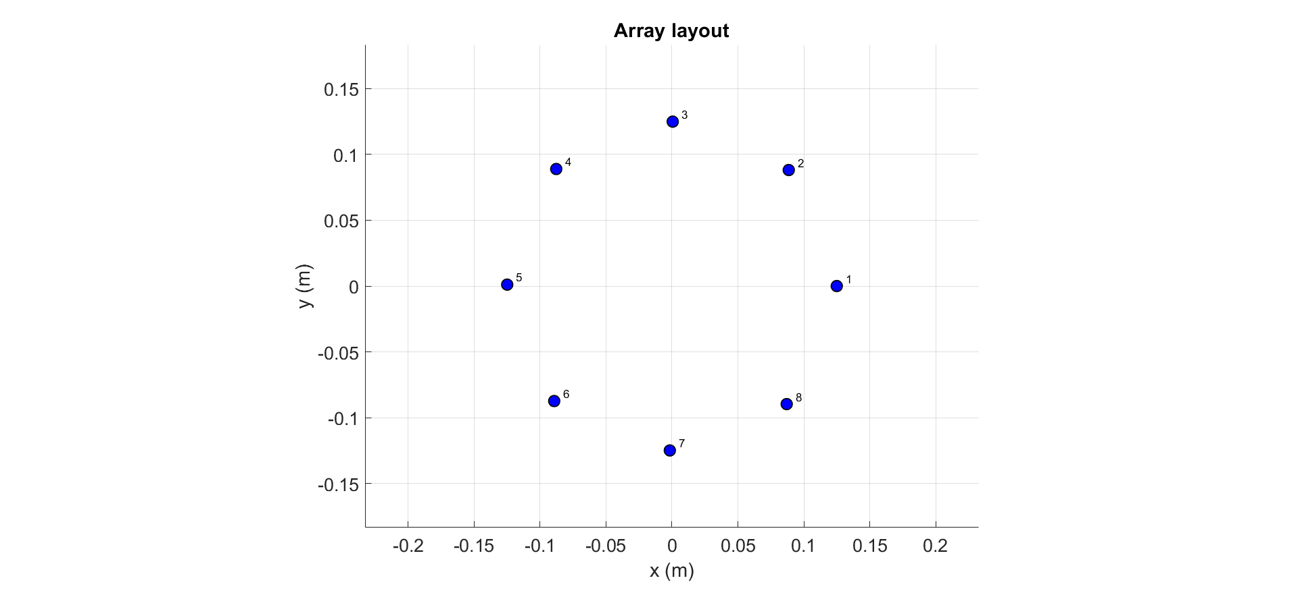
8 Element Dipole Circular Array

Slide 8
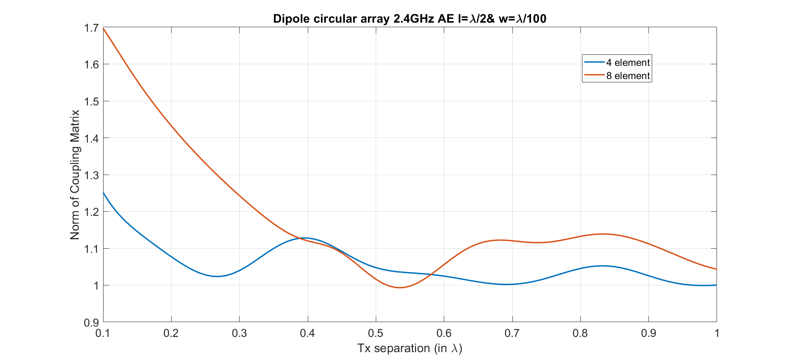
Coupling Matrix Norm vs Tx Separation Circular

Slide 9
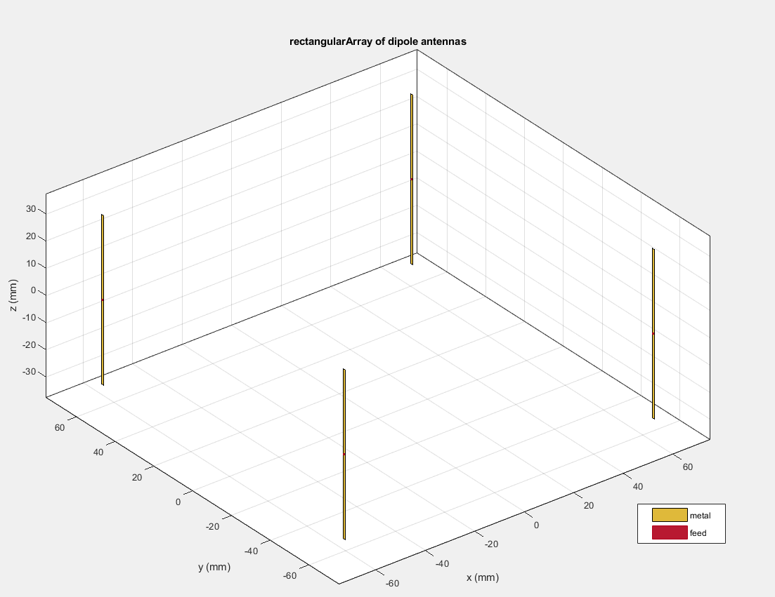
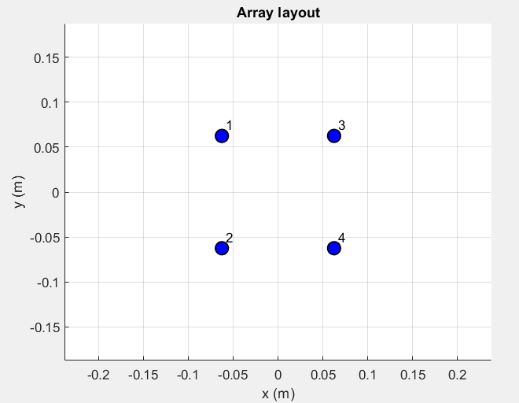
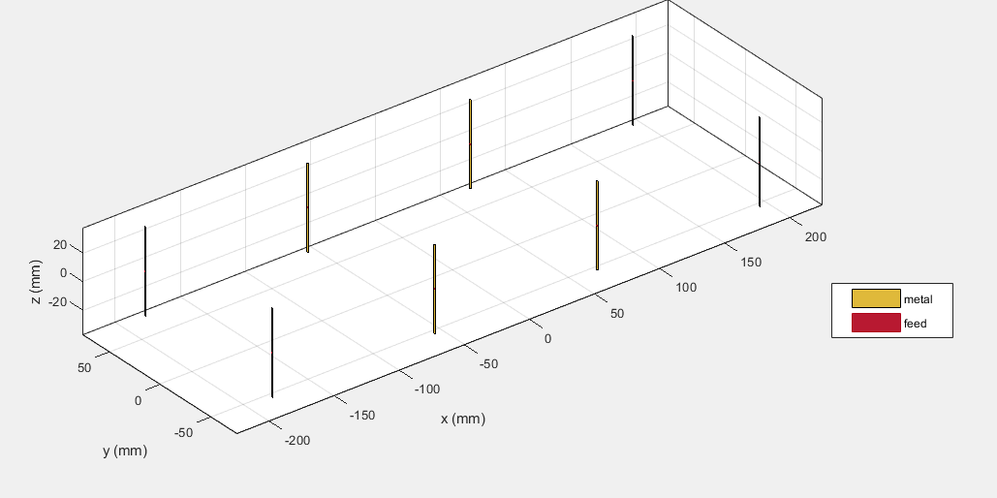

Dipole Rectangular Array

Slide 10
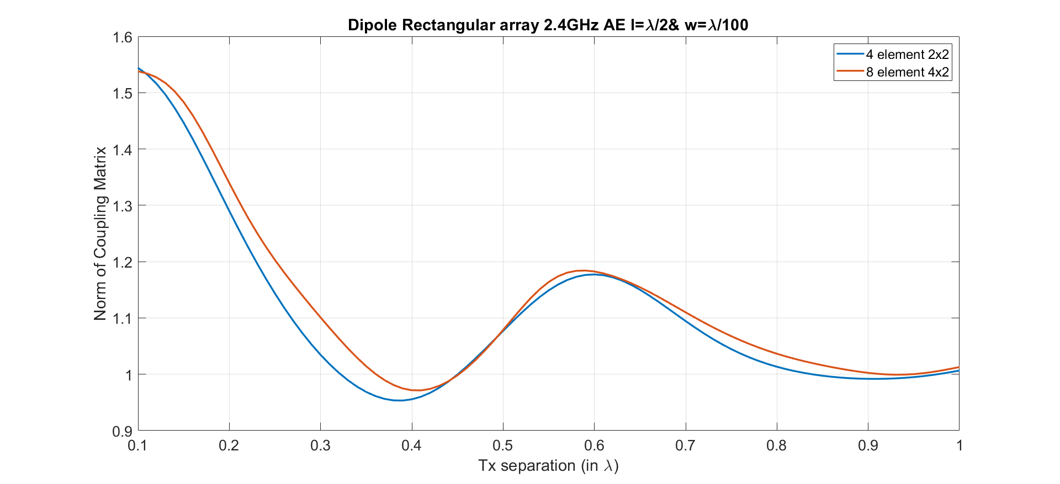
Coupling Matrix Norm vs Tx Separation Rectangular

Slide 11

Modelling Coupling Matrix →Spatial Correlation Matrix
[1] proposes a way to model mutual coupling matrix through spatial correlation matrix
Tx and Rx correlation matrices by pre and post-multiplying them by the corresponding coupling matrices.
This is valid under the assumption that the correlation and coupling can be modeled independently.
$$R_{\text{tx}}={\text{C}}_{\text{tx}}A_{\text{t}}{\text{C}}_{\text{tx}}^{\text{H}}{ R}_{\text{r}\text{x}}={\text{C}}_{\text{rx}}A_{\text{r}}{\text{C}}_{\text{rx}}^{\text{H}}$$
Rt and Rr are the transmit and receive correlation matrices, respectively
Ctx and Crx are the mutual coupling matrices for the transmit and receive antennas
Atx and Arx are the correlation matrices of transmit and receive antennas
[1] Wu, Yan, et al. "Effects of antenna mutual coupling on the performance of MIMO systems." 29th Symposium on Information Theory in the Benelux. 2008.

Slide 12
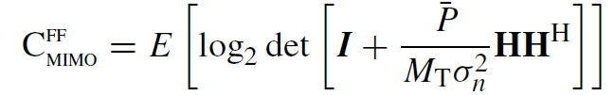
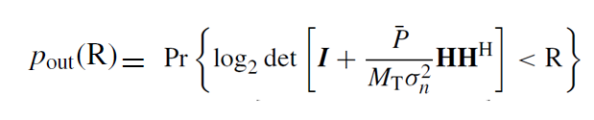
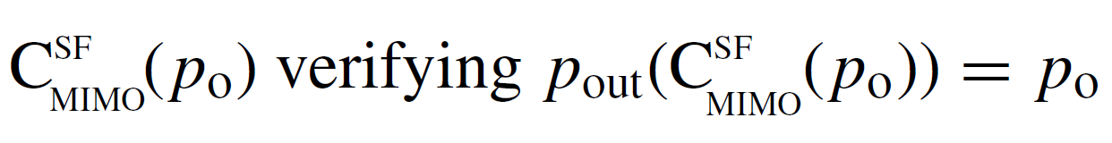
Performance Metrics of MIMO Channels
Fast fading Rayleigh
Slow fading Rayleigh
Ergodic Capacity
Outage Probability for a Rate R
Capacity with outage

Slide 13
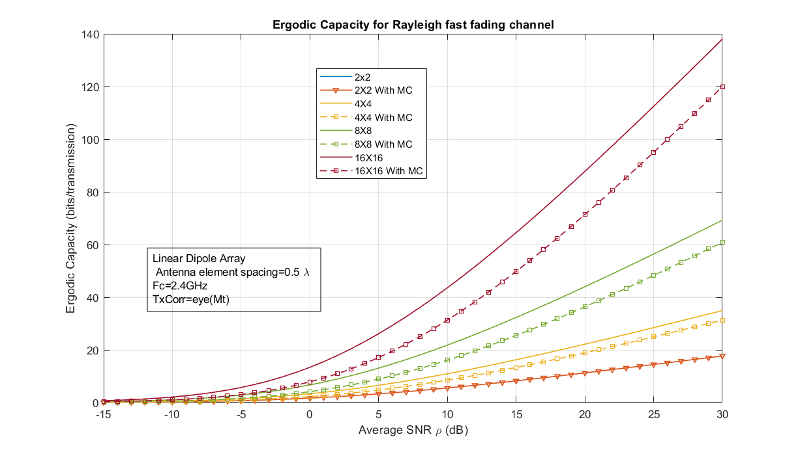
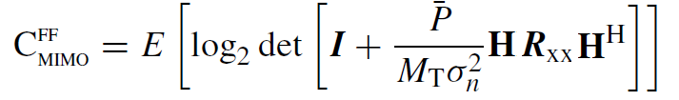

Rayleigh fast fading MIMO Channel Capacity with Mutual Coupling
Without Coupling
With Coupling
$$R_{\text{xx}}={\text{C}}_{\text{tx}}A_{\text{t}}{\text{C}}_{\text{tx}}^{\text{H}}$$

Slide 14
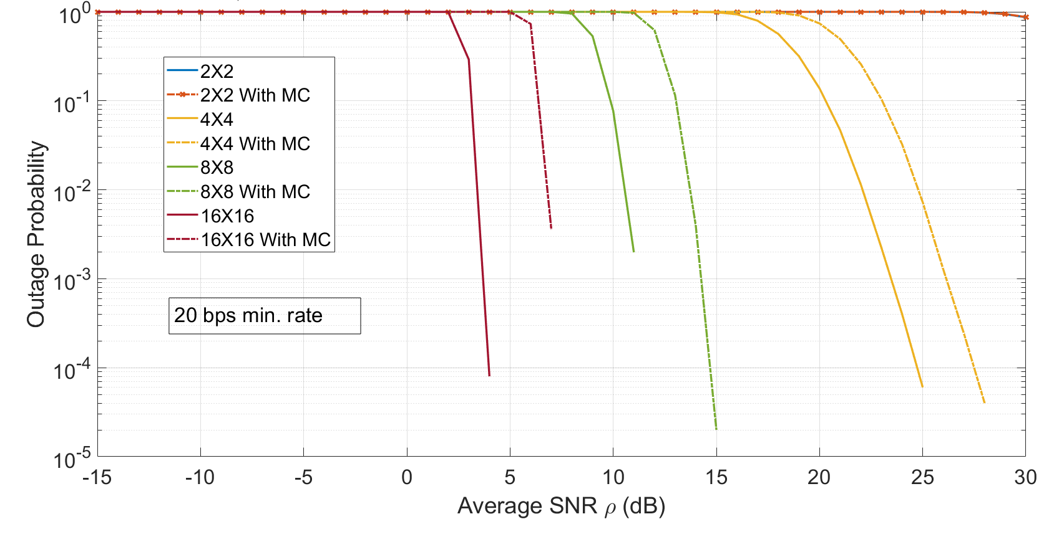
Rayleigh Slow fading MIMO Outage Probability with Mutual Coupling

Slide 15
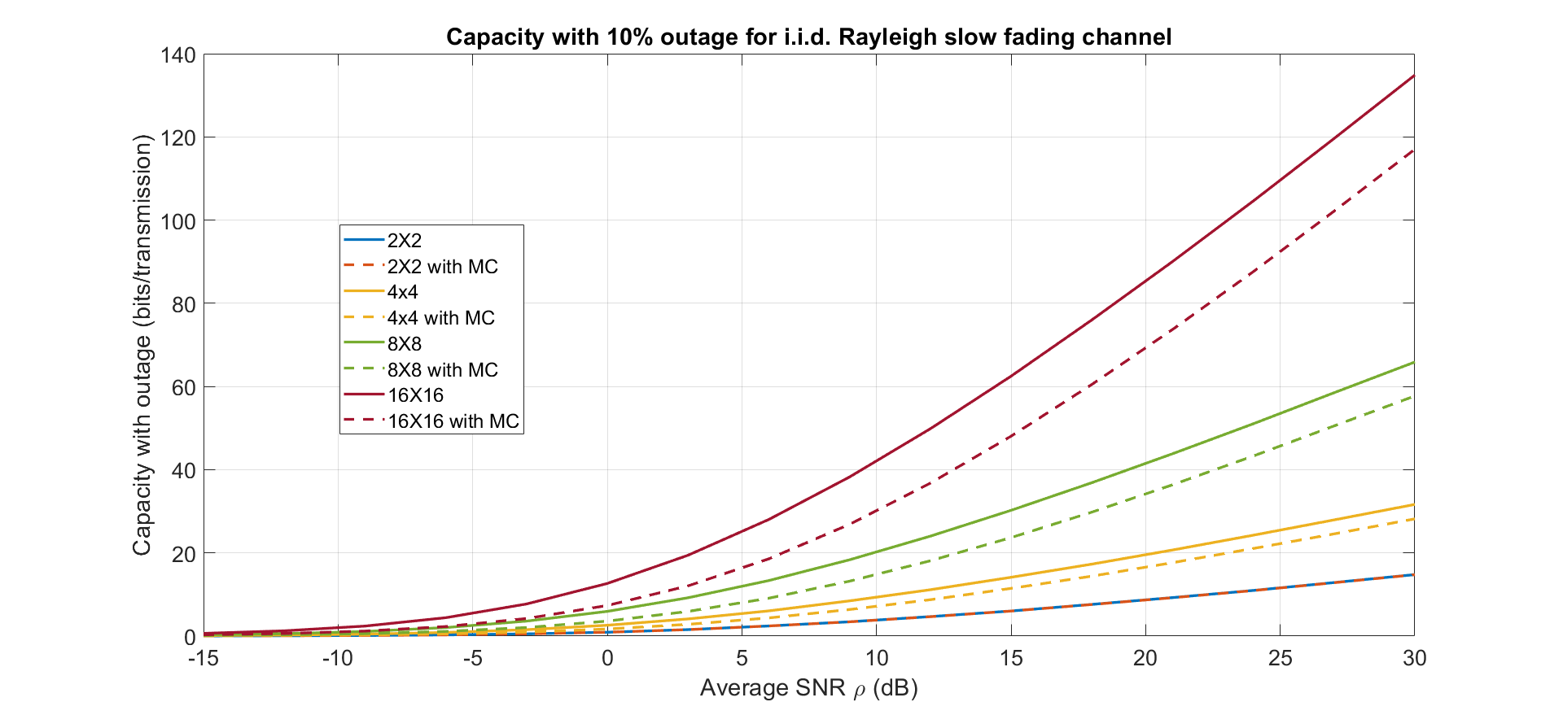
Rayleigh Slow fading MIMO Channel capacity with 10% Outage

Slide 16
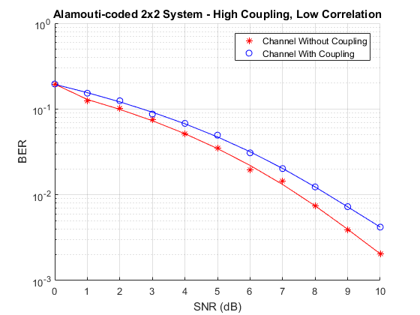
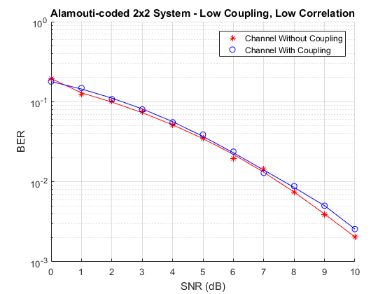
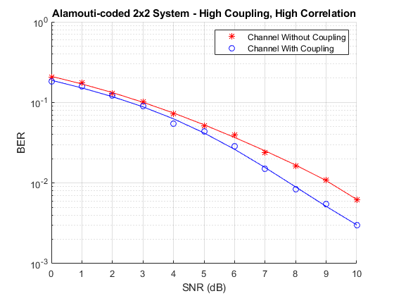
OSTBC Transmission with Antenna Coupling
BER vs. SNR curves are plotted under different correlation and coupling scenarios
QPSK modulated Alamouti OSTBC is simulated over a 2x2 quasi-static frequency-flat Rayleigh channel .
The system operates at 2.4 GHz. The SNR range to be simulated is 0 to 10 dB.
MathWorks example

Slide 17
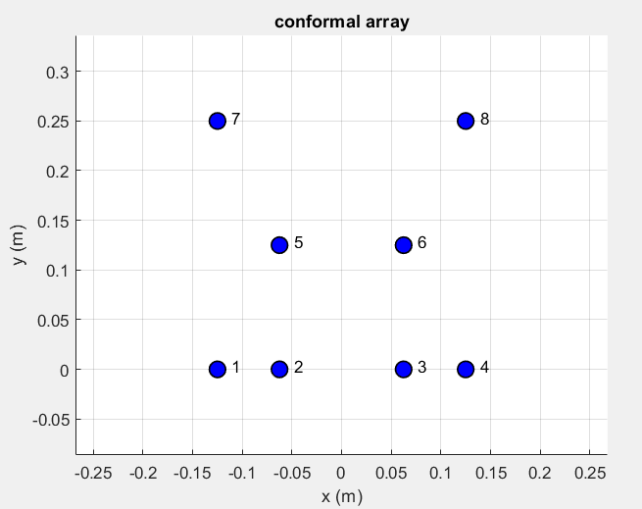

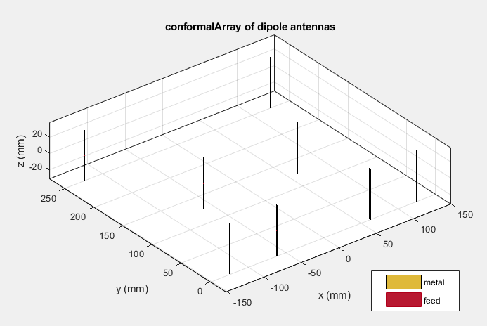
Extending array to conformal arrays

Slide 18
0.9964947 + 0.03925773i | 0.09980547 + 0.1054923i | 0.03544679 + 0.02699187i | -0.03293063 - 0.02430173i | -0.07073566 - 0.02654827i | 0.02257467 - 0.02549653i | -0.01688792 - 0.03858209i | 0.006618549 - 0.01879302i
0.09934901 + 0.1079030i | 0.6405391 - 0.07594541i | -0.03234355 - 0.02918137i | 0.02651217 + 0.01145875i | -0.03042938 - 0.04854085i | 0.005381745 + 0.04110922i | -0.01600636 - 0.01513570i | 0.01559561 + 0.01531875i
0.03348022 + 0.03407083i | -0.03319023 - 0.02872058i | 0.6430408 - 0.08252626i | 0.07703947 + 0.05690088i | 0.003525429 + 0.03897947i | -0.02930462 - 0.04415212i | 0.01514461 + 0.01479791i | -0.01706309 - 0.01337538i
-0.008613872 + 0.01921713i | 0.02454561 + 0.01853771i | 0.07658301 + 0.05931153i | 0.6547364 - 0.08631993i | 0.01153032 - 0.02176985i | -0.04793017 - 0.009210120i | 0.003140943 - 0.01416691i | -0.01460603 - 0.02341313i
-0.06899745 - 0.02639014i | -0.03035463 - 0.04818499i | 0.003274983 + 0.03949215i | 0.01218776 - 0.01810636i | 0.6598922 - 0.09141485i | -0.03989417 - 0.03738622i | -0.05448068 - 0.0008670022i | 0.01770655 - 0.02162062i
0.02191723 - 0.02916002i | 0.005632191 + 0.04059654i | -0.02937937 - 0.04450799i | -0.04966837 - 0.009368249i | -0.03997586 - 0.03706454i | 0.6588151 - 0.09358639i | 0.01758122 - 0.02209660i | -0.05433752 - 0.002185190i
-0.01583214 - 0.03881936i | -0.01597224 - 0.01502586i | 0.01488410 + 0.01487216i | 0.001894791 - 0.01245670i | -0.05453622 - 0.0008061206i | 0.01772481 - 0.02222219i | 0.6624837 - 0.09733220i | -0.02248692 - 0.02257242i
0.007864701 - 0.02050323i | 0.01585611 + 0.01524450i | -0.01709721 - 0.01348522i | -0.01566181 - 0.02317587i | 0.01756295 - 0.02149504i | -0.05428198 - 0.002246071i | -0.02257656 - 0.02256666i | 0.6629532 - 0.09779043i

Slide 19
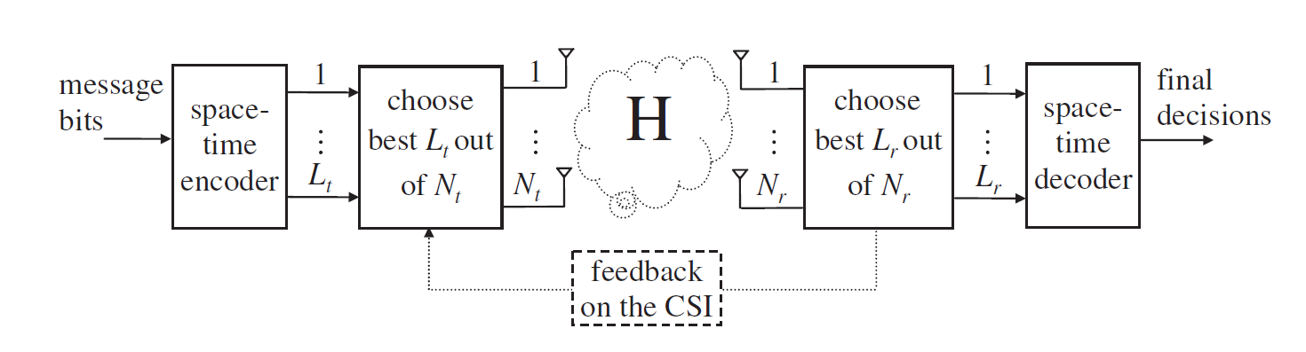
Generic MIMO system model with antenna selection

Slide 20
Antenna Selection for MIMO Systems

Slide 21
Antenna Selection
Capacity Based
Energy Based

Slide 22
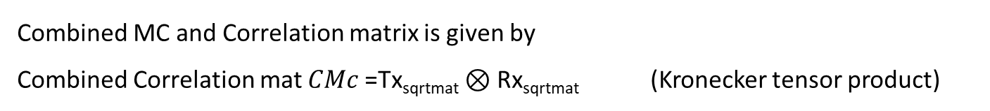
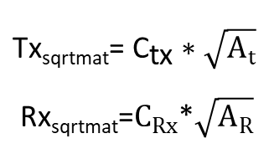

Modelling Coupling Matrix →Spatial Correlation Matrix
We can treat the Tx/Rx coupling matrix as being "absorbed" into the Tx/Rx correlation matrix and derive the combined correlation matrix as follows
${\text{Tx}\text{sqrtmat}\text{= }\text{C}}_{\text{tx}}∗$ $\sqrt{A_{t}}$
Rx_{sqrtmat}=$C_{Rx}$*$\sqrt{A_{R}}$
Combined MC and Correlation matrix is given by
Combined Correlation mat $CMc$=$\text{Tx}\text{sqrtmat}⊗$ Rx_{sqrtmat} (Kronecker tensor product)
Final matrix $R_{xx}$ = $CMc$* $CMc′$
[1] Wu, Yan, et al. "Effects of antenna mutual coupling on the performance of MIMO systems." 29th Symposium on Information Theory in the Benelux. 2008.

